Slide 1
Relational Algebra in DBMS
15 Examples with Solutions & Table Visualization

Slide 2
What is Relational Algebra in DBMS?
Relational algebra refers to a procedural query language that takes relation instances as input and returns relation instances as output. It performs queries with the help of operators. A binary or unary operator can be used. They take in relations as input and produce relations as output. Recursive relational algebra is applied to a relationship, and intermediate outcomes are also considered relations.
Relational Algebra Operations
The following are the fundamental operations present in a relational algebra:
Select Operation
Project Operation
Union Operation
Set Different Operation
Cartesian Product Operation
Rename Operation

Slide 3
Employee
EMPLOYEE_NO | NAME | AGE
E-1 | Anant | 20
E-2 | Ashish | 23
E-3 | Baljeet | 25
E-4 | Harsh | 20
E-5 | Pranav | 22

Slide 4
Student
ROLL | NAME | AGE
1 | Aman | 20
2 | Atul | 18
3 | Baljeet | 19
4 | Harsh | 20
5 | Prateek | 21
6 | Prateek | 23

Slide 5
σ AGE=20 (STUDENT)
ROLL | NAME | AGE
1 | Aman | 20
4 | Harsh | 20

Slide 6
Project (∏)
Project operation is done by Projection Operator which is represented by "pi"(∏). It is used to retrieve certain attributes(columns) from the table. It is also known as vertical partitioning as it separates the table vertically. It is also a unary operator. Notation : ∏ a(r) Where ∏ is used to represent PROJECTION r is used to represent RELATION a is the attribute list Let's understand this with an example: Suppose we want the names of all students from STUDENT Relation.

Slide 7
∏ NAME(STUDENT)
NAME
Aman
Atul
Baljeet
Harsh
Prateek

Slide 8
∏ ROLL,NAME(STUDENT)
ROLL | NAME
1 | Aman
2 | Atul
3 | Baljeet
4 | Harsh
5 | Prateek
6 | Prateek

Slide 9
Union (∪)
Union operation is done by Union Operator which is represented by "union"(∪). It is the same as the union operator from set theory, i.e., it selects all tuples from both relations but with the exception that for the union of two relations/tables both relations must have the same set of Attributes. It is a binary operator as it requires two operands. Notation: R ∪ S Where R is the first relation S is the second relation
If relations don't have the same set of attributes, then the union of such relations will result in NULL.
Let's have an example to clarify the concept: Suppose we want all the names from STUDENT and EMPLOYEE relation.

Slide 10
∏ NAME(STUDENT) ∪ ∏ NAME(EMPLOYEE)
NAME
Aman
Anant
Ashish
Atul
Baljeet
Harsh
Pranav
Prateek

Slide 11
Set Difference (-)
Set Difference as its name indicates is the difference between two relations (R-S). It is denoted by a "Hyphen"(-) and it returns all the tuples(rows) which are in relation R but not in relation S. It is also a binary operator. Notation : R - S Where R is the first relation S is the second relation
Just like union, the set difference also comes with the exception of the same set of attributes in both relations.

Slide 12
∏ NAME(STUDENT) - ∏ NAME(EMPLOYEE)
NAME
Aman
Atul
Prateek

Slide 13
Cartesian product (X)
Cartesian product is denoted by the "X" symbol. Let's say we have two relations R and S. Cartesian product will combine every tuple(row) from R with all the tuples from S. I know it sounds complicated, but once we look at an example, you'll see what I mean. Notation: R X S Where R is the first relation S is the second relation
As we can see from the notation it is also a binary operator.
Let's combine the two relations STUDENT and EMPLOYEE.

Slide 14
STUDENT X EMPLOYEE
ROLL | NAME | AGE | EMPLOYEE_NO | NAME | AGE
1 | Aman | 20 | E-1 | Anant | 20
1 | Aman | 20 | E-2 | Ashish | 23
1 | Aman | 20 | E-3 | Baljeet | 25
1 | Aman | 20 | E-4 | Harsh | 20
1 | Aman | 20 | E-5 | Pranav | 22
2 | Atul | 18 | E-1 | Anant | 20
2 | Atul | 18 | E-2 | Ashish | 23
2 | Atul | 18 | E-3 | Baljeet | 25
2 | Atul | 18 | E-4 | Harsh | 20
2 | Atul | 18 | E-5 | Pranav | 22

Slide 15
Cross Product (X)
Cross Product is done between two relations. It takes two relations as an input and gives one relation the cross product as the output. If there are X attributes in 1st relation and Y in 2nd relation then the final relation will have X+Y attributes. The number of tuples in the Final relation will be X*Y.

Slide 16
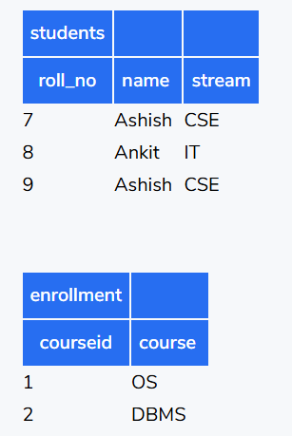

Slide 17
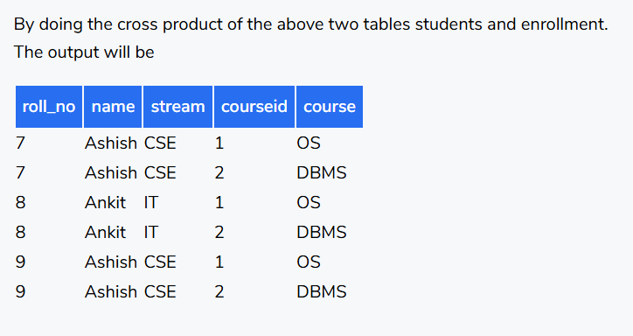

Slide 18
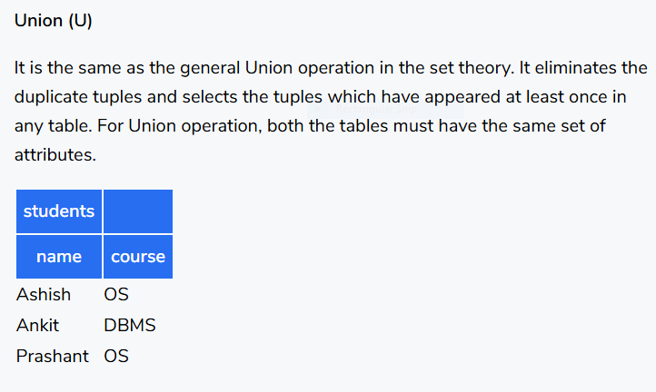

Slide 19
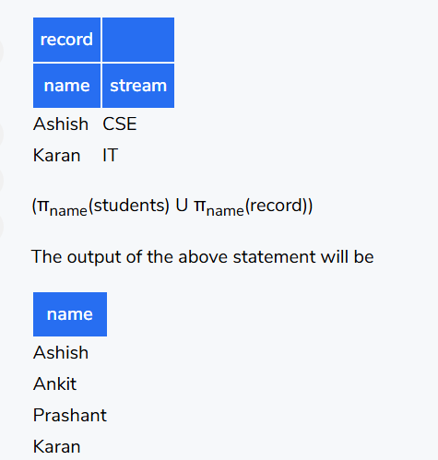

Slide 20
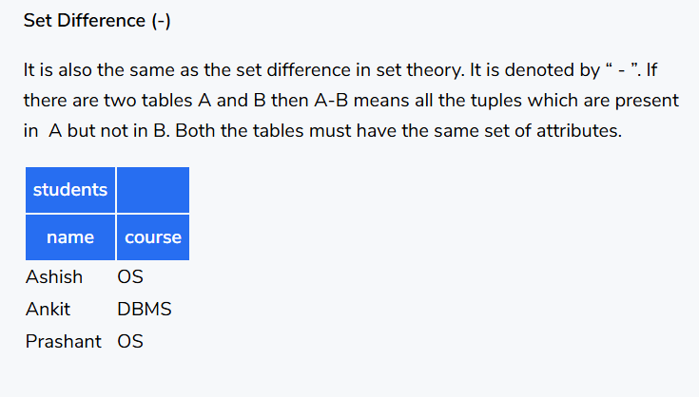

Slide 21
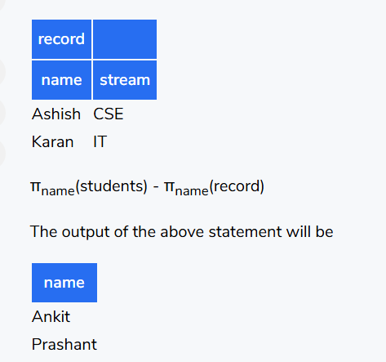

Slide 22
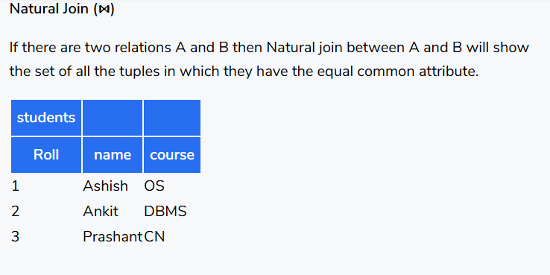

Slide 23
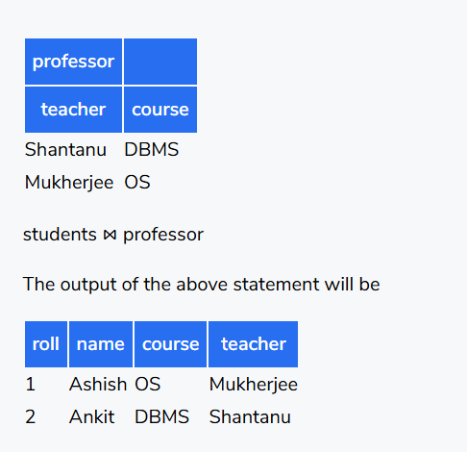

Slide 24
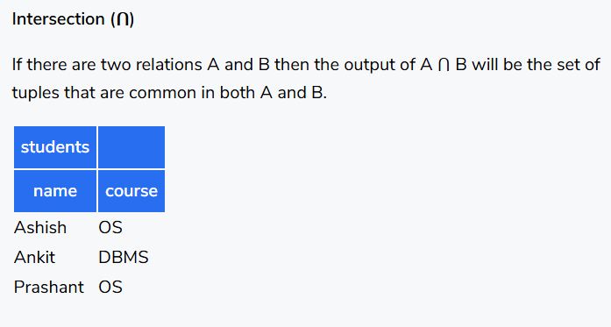
Conditional Join
It is also similar to natural join. The only difference between Natural Join and Conditional Join is in natural join the attributes must be equal by default but in conditional join, we can specify the conditions like greater than, less than, etc.

Slide 25
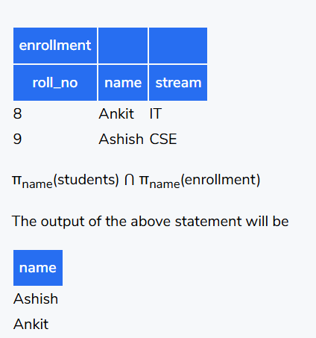

Slide 26
Division operation
The division operator is used for queries which involve the 'all'.
R1 ÷ R2 = tuples of R1 associated with all tuples of R2.
Example
Retrieve the name of the subject that is taught in all courses.

Slide 27
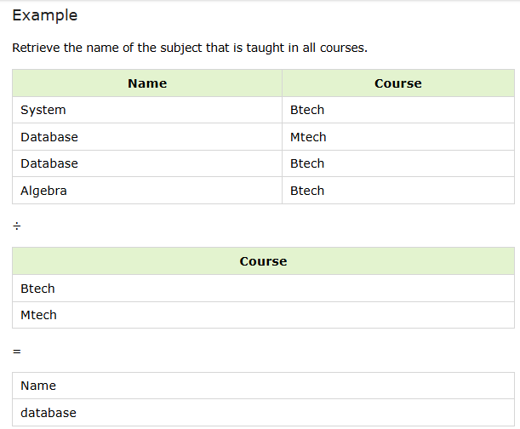

Slide 28
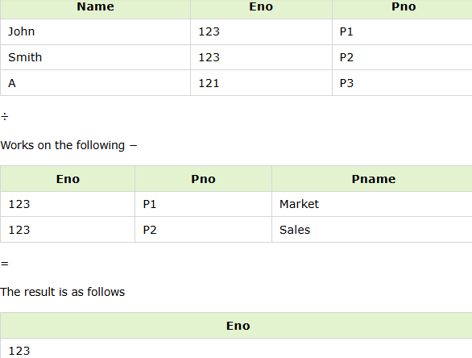

Slide 29
Rename (ρ)
Rename operation is denoted by "Rho"(ρ). As its name suggests it is used to rename the output relation. Rename operator too is a binary operator. Notation: ρ(R,S) Where R is the new relation name S is the old relation name

Slide 30
ρ(STUDENT_NAME,∏ NAME(STUDENT)) o/p:-STUDENT_NAME
NAME
Aman
Atul
Baljeet
Harsh
Prateek

Slide 31
Derived Operations
Also known as extended operations, these operations can be derived from basic operations and hence named Derived Operations. These include three operations: Join Operations, Intersection operations, and Division operations.
Let's study them one by one.
Join Operations
Join Operation in DBMS are binary operations that allow us to combine two or more relations. They are further classified into two types: Inner Join, and Outer Join.
First, let's have two relations EMPLOYEE consisting of E_NO, E_NAME, CITY and EXPERIENCE. EMPLOYEE table contains employee's information such as id, name, city, and experience of employee(In Years). The other relation is DEPARTMENT consisting of D_NO, D_NAME, E_NO and MIN_EXPERIENCE.
DEPARTMENT table defines the mapping of an employee to their department. It contains Department Number, Department Name, Employee Id of the employee working in that department, and the minimum experience required(In Years) to be in that department.

Slide 32
Employee
E_NO | E_NAME | CITY | EXPERIENCE
E-1 | Ram | Delhi | 04
E-2 | Varun | Chandigarh | 09
E-3 | Ravi | Noida | 03
E-4 | Amit | Bangalore | 07

Slide 33
Department
D_NO | D_NAME | E_NO | MIN_EXPERIENCE
D-1 | HR | E-1 | 03
D-2 | IT | E-2 | 05
D-3 | Marketing | E-3 | 02

Slide 34
E_NO | E_NAME | CITY | EXPERIENCE | D_NO | D_NAME | E_NO | MIN_EXPERIENCE
E-1 | Ram | Delhi | 04 | D-1 | HR | E-1 | 03
E-1 | Ram | Delhi | 04 | D-2 | IT | E-2 | 05
E-1 | Ram | Delhi | 04 | D-3 | Marketing | E-3 | 02
E-2 | Varun | Chandigarh | 09 | D-1 | HR | E-1 | 03
E-2 | Varun | Chandigarh | 09 | D-2 | IT | E-2 | 05
E-2 | Varun | Chandigarh | 09 | D-3 | Marketing | E-3 | 02
E-3 | Ravi | Noida | 03 | D-1 | HR | E-1 | 03
E-3 | Ravi | Noida | 03 | D-2 | IT | E-2 | 05
E-3 | Ravi | Noida | 03 | D-3 | Marketing | E-3 | 02
E-4 | Amit | Bangalore | 07 | D-1 | HR | E-1 | 03
E-4 | Amit | Bangalore | 07 | D-2 | IT | E-2 | 05
E-4 | Amit | Bangalore | 07 | D-3 | Marketing

Slide 35
Contd..
Inner Join
When we perform Inner Join, only those tuples returned that satisfy the certain condition. It is also classified into three types: Theta Join, Equi Join and Natural Join.
Theta Join (θ)
Theta Join combines two relations using a condition. This condition is represented by the symbol "theta"(θ). Here conditions can be inequality conditions such as >,<,>=,<=, etc. Notation : R ⋈θ S Where R is the first relation S is the second relation
Let's have a simple example to understand this.
Suppose we want a relation where EXPERIENCE from EMPLOYEE >= MIN_EXPERIENCE from DEPARTMENT.

Slide 36
EMPLOYEE⋈θ EMPLOYEE.EXPERIENCE>=DEPARTMENT.MIN_EXPERIENCE DEPARTMENT
EMPLOYEE⋈θ EMPLOYEE.EXPERIENCE>=DEPARTMENT.MIN_EXPERIENCE DEPARTMENT

Slide 37
E_NO | E_NAME | CITY | EXPERIENCE | D_NO | D_NAME | E_NO | MIN_EXPERIENCE
E-1 | Ram | Delhi | 04 | D-1 | HR | E-1 | 03
E-1 | Ram | Delhi | 04 | D-3 | Marketing | E-3 | 02
E-2 | Varun | Chandigarh | 09 | D-1 | HR | E-1 | 03
E-2 | Varun | Chandigarh | 09 | D-2 | IT | E-2 | 05
E-2 | Varun | Chandigarh | 09 | D-3 | Marketing | E-3 | 02
E-3 | Ravi | Noida | 03 | D-1 | HR | E-1 | 03
E-3 | Ravi | Noida | 03 | D-3 | Marketing | E-3 | 02
E-4 | Amit | Bangalore | 07 | D-1 | HR | E-1 | 03
E-4 | Amit | Bangalore | 07 | D-2 | IT | E-2 | 05
E-4 | Amit | Bangalore | 07 | D-3 | Marketing | E-3 | 02

Slide 38
Check the Cartesian Product, if in any tuple/row EXPERIENCE >= MIN_EXPERIENCE then insert this tuple/row in output relation.
Equi Join
Equi Join is a special case of theta join where the condition can only contain **equality(=)** comparisons. A non-equijoin is the inverse of an equi join, which occurs when you join on a condition other than "=".
Let's have an example where we would like to join EMPLOYEE and DEPARTMENT relation where E_NO from EMPLOYEE = E_NO from DEPARTMENT.

Slide 39
EMPLOYEE ⋈EMPLOYEE.E_NO = DEPARTMENT.E_NO DEPARTMENT
E_NO | E_NAME | CITY | EXPERIENCE | D_NO | D_NAME | E_NO | MIN_EXPERIENCE
E-1 | Ram | Delhi | 04 | D-1 | HR | E-1 | 03
E-2 | Varun | Chandigarh | 09 | D-2 | IT | E-2 | 05
E-3 | Ravi | Noida | 03 | D-3 | Marketing | E-3 | 02

Slide 40
Contd..
Natural Join (⋈)
A comparison operator is not used in a natural join. It does not concatenate like a Cartesian product. A Natural Join can be performed only if two relations share at least one common attribute. Furthermore, the attributes must share the same name and domain. Natural join operates on matching attributes where the values of the attributes in both relations are the same and remove the duplicate ones. Preferably Natural Join is performed on the foreign key. Notation : R ⋈ S Where R is the first relation S is the second relation
Let's say we want to join EMPLOYEE and DEPARTMENT relation with E_NO as a common attribute.
Notice, here E_NO has the same name in both the relations and also consists of the same domain, i.e., in both relations E_NO is a string.

Slide 41
EMPLOYEE ⋈ DEPARTMENT
E_NO | E_NAME | CITY | EXPERIENCE | D_NO | D_NAME | MIN_EXPERIENCE
E-1 | Ram | Delhi | 04 | D-1 | HR | 03
E-2 | Varun | Chandigarh | 09 | D-2 | IT | 05
E-3 | Ravi | Noida | 03 | D-3 | Marketing | 02

Slide 42
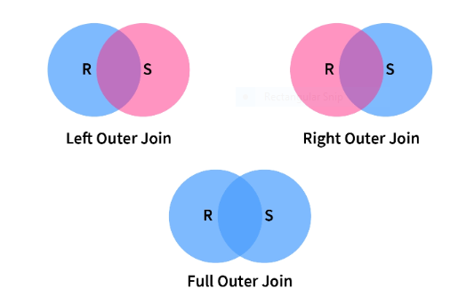

Slide 43
Left Outer Join
As we can see from the diagram, Left Outer Join returns the matching tuples(tuples present in both relations) and the tuples which are only present in Left Relation, here R.
However, if the matching tuples are NULL, then attributes/columns of Right Relation, here S are made NULL in the output relation.
Let's understand this a bit more using an example:
EMPLOYEE ⟕EMPLOYEE.E_NO = DEPARTMENT.E_NO DEPARTMENT

Slide 44
Here we are combining EMPLOYEE and DEPARTMENT relation with the constraint that EMPLOYEE's E_NO must be equal to DEPARTMENT's E_NO.
E_NO | E_NAME | CITY | EXPERIENCE | D_NO | D_NAME | MIN_EXPERIENCE
E-1 | Ram | Delhi | 04 | D-1 | HR | 03
E-2 | Varun | Chandigarh | 09 | D-2 | IT | 05
E-3 | Ravi | Noida | 03 | D-3 | Marketing | 02
E-4 | Amit | Bangalore | 07 | - | - | -

Slide 45
As you can see here, all the tuples from left, i.e., EMPLOYEE relation are present. But E-4 is not satisfying the given condition, i.e., E_NO from EMPLOYEE must be equal to E_NO from DEPARTMENT, still it is included in the output relation. This is because Outer Join also includes some/all the tuples which don't satisfy the condition. That's why Outer Join marked E-4's corresponding tuple/row from DEPARTMENT as NULL.
Right Outer Join
Right Outer Join returns the matching tuples and the tuples which are only present in Right Relation here S.
The same happens with the Right Outer Join, if the matching tuples are NULL, then the attributes of Left Relation, here R are made NULL in the output relation.
We will combine EMPLOYEE and DEPARTMENT relations with the same constraint as above.

Slide 46
EMPLOYEE ⟖EMPLOYEE.E_NO = DEPARTMENT.E_NO DEPARTMENT
E_NO | E_NAME | CITY | EXPERIENCE | D_NO | D_NAME | MIN_EXPERIENCE
E-1 | Ram | Delhi | 04 | D-1 | HR | 03
E-2 | Varun | Chandigarh | 09 | D-2 | IT | 05
E-3 | Ravi | Noida | 03 | D-3 | Marketing | 02

Slide 47
Full Outer Join
Full Outer Join returns all the tuples from both relations. However, if there are no matching tuples then, their respective attributes are made NULL in output relation.
Again, combine the EMPLOYEE and DEPARTMENT relation with the same constraint.
Ex-EMPLOYEE ⟗EMPLOYEE.E_NO = DEPARTMENT.E_NO DEPARTMENT

Slide 48
E_NO | E_NAME | CITY | EXPERIENCE | D_NO | D_NAME | MIN_EXPERIENCE
E-1 | Ram | Delhi | 04 | D-1 | HR | 03
E-2 | Varun | Chandigarh | 09 | D-2 | IT | 05
E-3 | Ravi | Noida | 03 | D-3 | Marketing | 02
E-4 | Amit | Bangalore | 07 | - | - | -

Slide 49
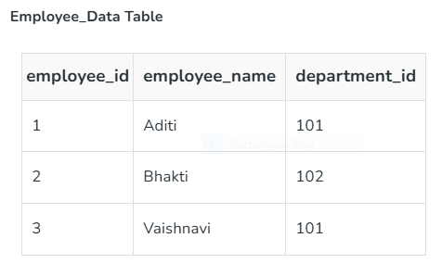
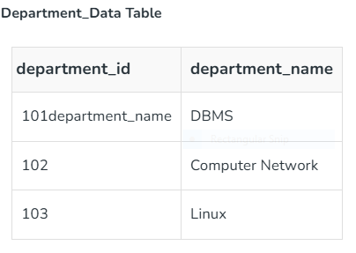
Example

Slide 50
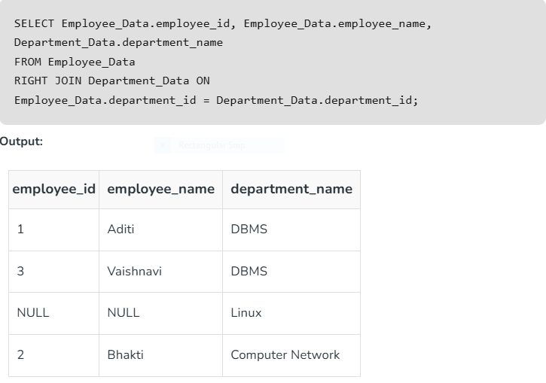
Right Join

Slide 51
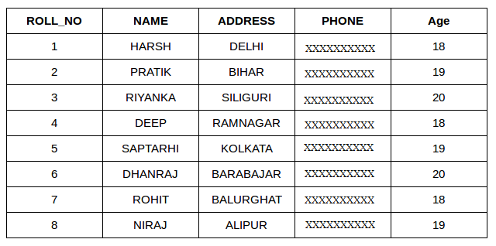
Student table

Slide 52
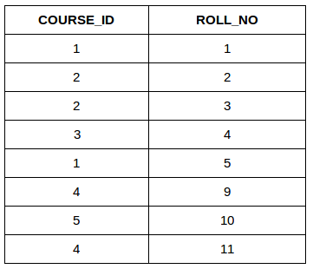
Course Table

Slide 53
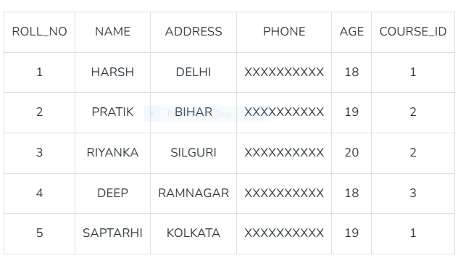
Query:
SELECT s.roll_no, s.name, s.address, s.phone, s.age, sc.course_id FROM Student s JOIN StudentCourse sc ON s.roll_no = sc.roll_no;

Slide 54
1. SQL INNER JOIN
The INNER JOIN keyword selects all rows from both the tables as long as the condition is satisfied. This keyword will create the result-set by combining all rows from both the tables where the condition satisfies i.e value of the common field will be the same.
Syntax
SELECT table1.column1,table1.column2,table2.column1,....
FROM table1
INNER JOIN table2
ON table1.matching_column = table2.matching_column;
Key Terms
table1: First table.
table2: Second table
matching_column: Column common to both the tables.
Note: We can also write JOIN instead of INNER JOIN. JOIN is same as INNER JOIN.

Slide 55
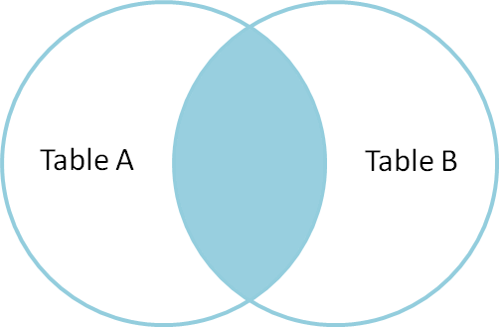

Slide 56
INNER JOIN Example
Let’s look at the example of INNER JOIN clause, and understand it’s working. This query will show the names and age of students enrolled in different courses.
Query:
SELECT StudentCourse.COURSE_ID, Student.NAME, Student.AGE FROM Student
INNER JOIN StudentCourse
ON Student.ROLL_NO = StudentCourse.ROLL_NO;

Slide 57
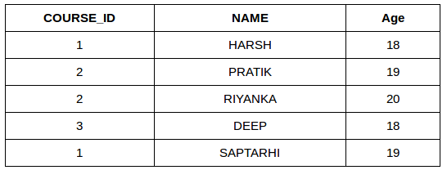

Slide 58
2. SQL LEFT JOIN
LEFT JOIN returns all the rows of the table on the left side of the join and matches rows for the table on the right side of the join. For the rows for which there is no matching row on the right side, the result-set will contain null. LEFT JOIN is also known as LEFT OUTER JOIN.
Syntax
SELECT table1.column1,table1.column2,table2.column1,....
FROM table1
LEFT JOIN table2
ON table1.matching_column = table2.matching_column;
Key Terms
table1: First table.
table2: Second table
matching_column: Column common to both the tables.

Slide 59
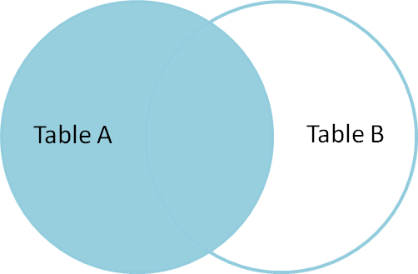

Slide 60
LEFT JOIN Example
In this example, the LEFT JOIN retrieves all rows from the Student table and the matching rows from the StudentCourse table based on the ROLL_NO column.
Query:
SELECT Student.NAME,StudentCourse.COURSE_ID
FROM Student
LEFT JOIN StudentCourse
ON StudentCourse.ROLL_NO = Student.ROLL_NO;

Slide 61
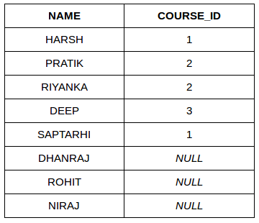

Slide 62
3. SQL RIGHT JOIN
RIGHT JOIN returns all the rows of the table on the right side of the join and matching rows for the table on the left side of the join. It is very similar to LEFT JOIN for the rows for which there is no matching row on the left side, the result-set will contain null. RIGHT JOIN is also known as RIGHT OUTER JOIN.
Syntax
SELECT table1.column1,table1.column2,table2.column1,....
FROM table1
RIGHT JOIN table2
ON table1.matching_column = table2.matching_column;
Key Terms
table1: First table.
table2: Second table
matching_column: Column common to both the tables.
Note: We can also use RIGHT OUTER JOIN instead of RIGHT JOIN, both are the same.

Slide 63
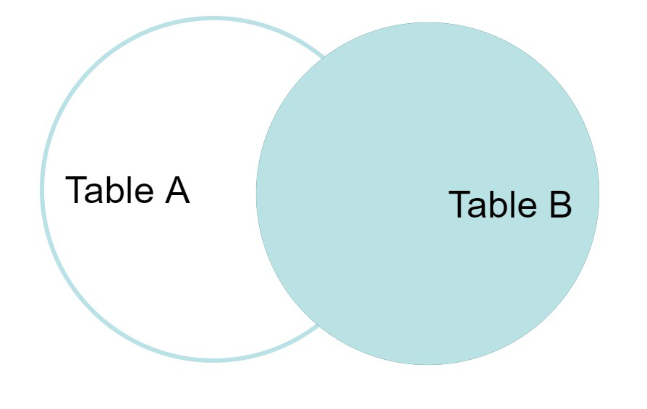

Slide 64
RIGHT JOIN Example
In this example, the RIGHT JOIN retrieves all rows from the StudentCourse table and the matching rows from the Student table based on the ROLL_NO column.
Query:
SELECT Student.NAME,StudentCourse.COURSE_ID
FROM Student
RIGHT JOIN StudentCourse
ON StudentCourse.ROLL_NO = Student.ROLL_NO;

Slide 65
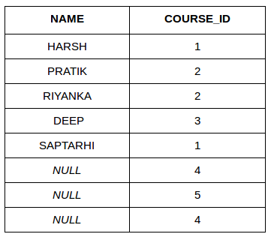

Slide 66
4. SQL FULL JOIN
FULL JOIN creates the result-set by combining results of both LEFT JOIN and RIGHT JOIN. The result-set will contain all the rows from both tables. For the rows for which there is no matching, the result-set will contain NULL values.

Slide 67
Syntax
SELECT table1.column1,table1.column2,table2.column1,....
FROM table1
FULL JOIN table2
ON table1.matching_column = table2.matching_column;
Key Terms
table1: First table.
table2: Second table
matching_column: Column common to both the tables.

Slide 68
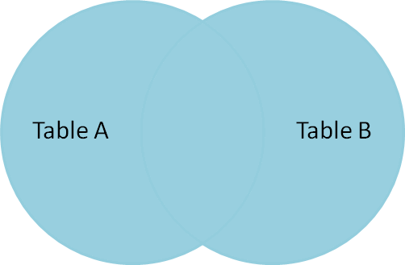

Slide 69
FULL JOIN Example
This example demonstrates the use of a FULL JOIN, which combines the results of both LEFT JOIN and RIGHT JOIN. The query retrieves all rows from the Student and StudentCourse tables. If a record in one table does not have a matching record in the other table, the result set will include that record with NULL values for the missing fields
Query:
SELECT Student.NAME,StudentCourse.COURSE_ID
FROM Student
FULL JOIN StudentCourse
ON StudentCourse.ROLL_NO = Student.ROLL_NO;

Slide 70
O/p
NAME | COURSE_ID
HARSH | 1
PRATIK | 2
RIYANKA | 2
DEEP | 3
SAPTARHI | 1
DHANRAJ | NULL
ROHIT | NULL
NIRAJ | NULL
NULL | 4
NULL | 5
NULL | 4

Slide 71
5. SQL Natural Join (?)
Natural join can join tables based on the common columns in the tables being joined. A natural join returns all rows by matching values in common columns having same name and data type of columns and that column should be present in both tables.
Both table must have at least one common column with same column name and same data type.
The two table are joined using Cross join.
DBMS will look for a common column with same name and data type. Tuples having exactly same values in common columns are kept in result.
Natural join Example
Look at the two tables below- Employee and Department

Slide 72
Employee
Emp_id | Emp_name | Dept_id
1 | Ram | 10
2 | Jon | 30
3 | Bob | 50

Slide 73
Department
Dept_id | Dept_name
10 | IT
30 | HR
40 | TIS

Slide 74
Emp_id | Emp_name | Dept_id | Dept_id | Dept_name
1 | Ram | 10 | 10 | IT
2 | Jon | 30 | 30 | HR
Employee data |  |  | Department data

Slide 75
Intersection (∩)
Intersection operation is done by Intersection Operator which is represented by "intersection"(∩).It is the same as the intersection operator from set theory, i.e., it selects all the tuples which are present in both relations. It is a binary operator as it requires two operands. Also, it eliminates duplicates. Notation : R ∩ S Where R is the first relation S is the second relation
Let's have an example to clarify the concept: Suppose we want the names which are present in STUDENT as well as in EMPLOYEE relation, Relations we used in Basic Operations.
Ex-∏ NAME(STUDENT) ∩ ∏ NAME(EMPLOYEE)

Slide 76
NAME
Baljeet
Harsh

Slide 77
Division (÷)
Division Operation is represented by "division"(÷ or /) operator and is used in queries that involve keywords "every", "all", etc. Notation : R(X,Y)/S(Y) Here, R is the first relation from which data is retrieved. S is the second relation that will help to retrieve the data. X and Y are the attributes/columns present in relation. We can have multiple attributes in relation, but keep in mind that attributes of S must be a proper subset of attributes of R. For each corresponding value of Y, the above notation will return us the value of X from tuple<X,Y> which exists everywhere.
It's a bit difficult to understand this in a theoretical way, but you will understand this with an example.
Let's have two relations, ENROLLED and COURSE. ENROLLED consist of two attributes STUDENT_ID and COURSE_ID. It denotes the map of students who are enrolled in given courses.
COURSE contains the list of courses available. See, here attributes/columns of COURSE relation are a proper subset of attributes/columns of ENROLLED relation. Hence Division operation can be used here.

Slide 78
ENROLLED
STUDENT_ID | COURSE_ID
Student_1 | DBMS
Student_2 | DBMS
Student_1 | OS
Student_3 | OS

Slide 79
Course
COURSE_ID
DBMS
OS

Slide 80
ENROLLED(STUDENT_ID, COURSE_ID)/COURSE(COURSE_ID)
STUDENT_ID
Student_1

Slide 81
Takeaway
Theta Join (θ) combines two relations based on a condition.
Equi Join is a type of Theta Join where only equality condition (=) is used.
Natural Join (⋈) combines two relations based on a common attribute (preferably foreign key).
Left Outer Join (⟕) returns the matching tuples and tuples which are only present in the left relation.
Right Outer Join (⟖) returns the matching tuples and tuples which are only present in the right relation.
Full Outer Join (⟗) returns all the tuples present in the left and right relations. :::
Conclusion
Relational Algebra in DBMS is a theoretical model which is the fundamental block for SQL. It comprises different mathematics operations.
Operations are divided into two main categories: Basic and Derived.
Basic consists of six Operations: SELECT, PROJECT, UNION, SET DIFFERENCE, CARTESIAN PRODUCT, RENAME.
Derived Consist of three Operations: JOINS, INTERSECTION, DIVISION.
Joins are of two types: Inner Join and Outer Join . Inner Join is further classified into three types: Theta Join, Equi Join, and Natural Join. Outer Join also consists of three types: Left Outer Join, Right Outer Join, and Full Outer Join.

Slide 82
Select (σ)
Select operation is done by Selection Operator which is represented by "sigma"(σ). It is used to retrieve tuples(rows) from the table where the given condition is satisfied. It is a unary operator means it requires only one operand. Notation : σ p(R) Where σ is used to represent SELECTION R is used to represent RELATION p is the logic formula Let's understand this with an example: Suppose we want the row(s) from STUDENT Relation where "AGE" is 20

Slide 83
Employee Table
EmpID | Name | Age | Department | Salary
------|--------|-----|------------|---------
101 | Alice | 25 | HR | 50000
102 | Bob | 28 | IT | 60000
103 | Charlie| 30 | IT | 70000
104 | David | 35 | Finance | 80000
105 | Eve | 27 | HR | 55000

Slide 84
1. Selection (σ) - Find IT Department Employees
Query: σ_Department='IT' (Employee)
Result:
EmpID | Name | Age | Department | Salary
------|--------|-----|------------|---------
102 | Bob | 28 | IT | 60000
103 | Charlie| 30 | IT | 70000

Slide 85
2. Projection (π) - Names and Salaries
Query: π_Name, Salary (Employee)
Result:
Name | Salary
--------|---------
Alice | 50000
Bob | 60000
Charlie| 70000
David | 80000
Eve | 55000

Slide 86
3. Cartesian Product (×) - Employee and Project
Query: Employee × Project
Result: (Partial View)
EmpID | Name | Age | ProjID | ProjName
------|--------|-----|--------|----------
101 | Alice | 25 | P1 | Alpha
102 | Bob | 28 | P2 | Beta

Slide 87
4. Natural Join (⨝) - Employees and Projects
Query: Employee ⨝ Project
Result:
EmpID | Name | Age | Department | Salary | ProjID | ProjName
------|--------|-----|------------|--------|--------|----------
101 | Alice | 25 | HR | 50000 | P1 | Alpha
102 | Bob | 28 | IT | 60000 | P2 | Beta

Slide 88
5. Aggregation - Average Salary
Query: G_AVG(Salary) (Employee)
Result:
Average Salary: (50000 + 60000 + 70000 + 80000 + 55000) / 5 = 63000

Slide 89
6. Outer Join - Employees with Projects
Query: Employee ⨝_EmpID^left outer Project
Result: Includes employees with and without projects

Slide 90
7-9. Set Operations - Union, Intersection, Difference
- Union (∪): Employee ∪ Manager
- Intersection (∩): Employee ∩ Manager
- Difference (-): Employee - Manager

Slide 91
Conclusion
- Relational Algebra is the foundation of query processing.
- Helps in SQL optimization and database management.
- Used for filtering, joining, aggregating, and transforming data.

Slide 92
Thank You!
Any Questions?

Slide 94
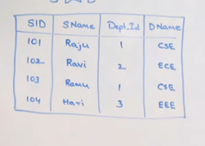

Slide 96
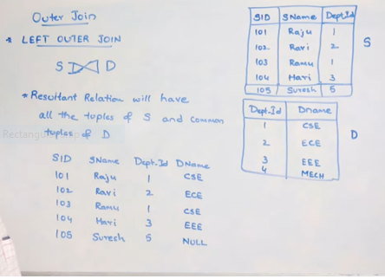

Slide 97
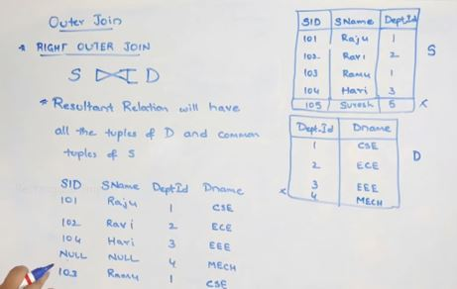

Slide 99
